Slide 1
Media Mix Model Scenario Planning & Optimization
CIMA Advanced Analytics & Optimization (AAO)
March 18, 2025

Slide 2
Overview
The media effectiveness and media timing results from media mix model (MMM) allows business users to run scenario forecast and media mix optimization when planning for future media budget. We have 2 available tools – Excel version and the SOUL webapp with different advantages.
Scenario Planning
Forecast of media-driven attendance given a media plan
Available in Excel / SOUL
Budget Minimizing
Answering “What’s the media mix I should choose to achieve a given attendance goal with the minimal total budget?”
Available in SOUL
Attendance Maximizing
Answering “Given my current media plan, how do I reshuffle the media mix to acquire the maximal attendance with the same total budget?”
Available in SOUL

Slide 3
Excel Version
Scenario Planning

Slide 4
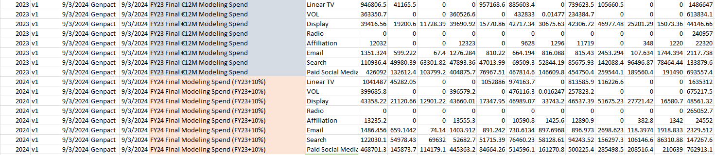
Scenario Planning
How would my attendance look like with my current plan?
User Input 1 -- Creating different scenarios
Go to “scenarios” tab
Add extra scenarios by filling cells following existing examples

Slide 5
Scenario Planning
How would my attendance look like with my current plan?
User Input 2 -- Choose the scenarios to compare
Go to “Summary Results” tab
In row 41 – 42, select the scenario names to compare

Slide 6
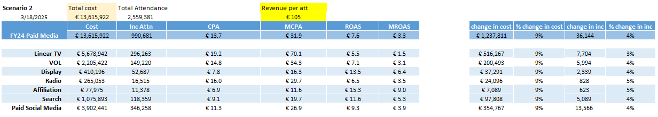
Scenario Planning
How would my attendance look like with my current plan?
Results – Aggregate Level Summary
Stay in “Summary Results” tab
In row 1 - 7

Slide 7
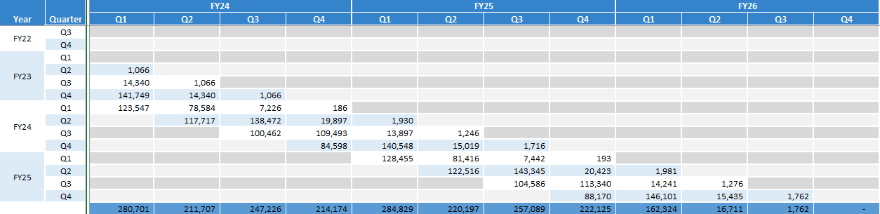
Scenario Planning
How would my attendance look like with my current plan?
Results – Attendance Forecast
Go to in “Monthly Timing” or “Quarterly Timing” tab
Each cell represents the attendance driven by media spent in corresponding row time. For example, the first column means there will be 280,701 media-driven attendance in FY24 Q1, and 1,066 of them is driven by media spent in FY23 Q2
The attendance forecast for scenario 2 is shown as for FY25, although both scenarios are planning for FY24

Slide 8
Scenario Planning
How would my attendance look like with my current plan?
Results – Attendance Forecast
Go to in “Monthly Timing” or “Quarterly Timing” tab
Each cell represents the attendance driven by media spent in corresponding row time. For example, the first column means there will be 280,701 media-driven attendance in FY24 Q1, and 1,066 of them is driven by media spent in FY23 Q2
The attendance forecast for scenario 2 is shown as for FY25, although both scenarios are planning for FY24

Slide 9
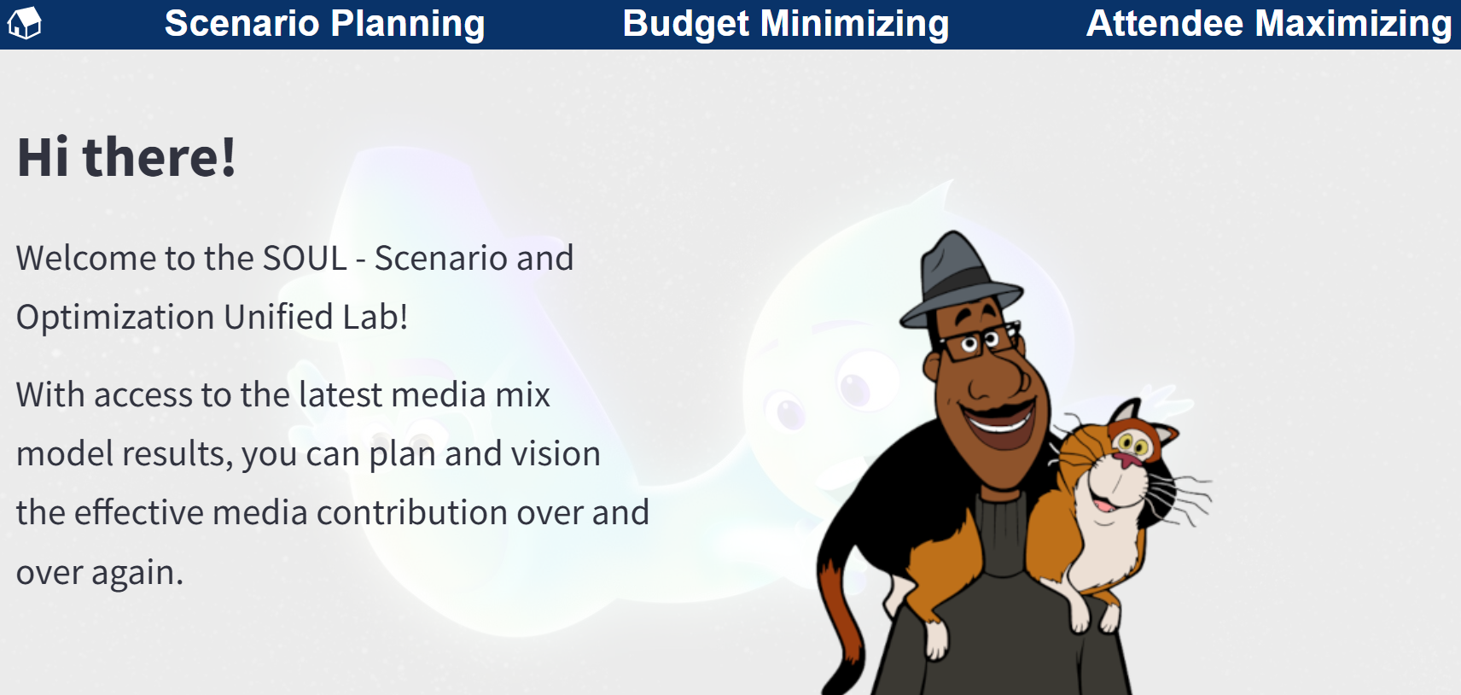
SOUL Webapp
Scenario Planning
Media Mix Optimization
Budget Minimizing
Attendance Maximizing

Slide 10

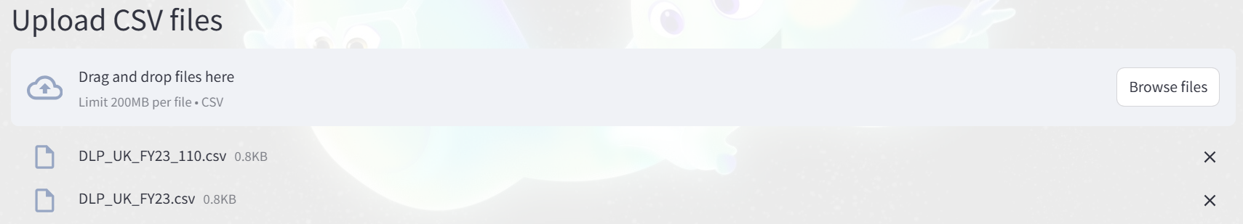
Scenario Planning
How would my attendance look like with my current plan?
User Input 1 -- Creating different scenarios
Using the template to create CSV files
Go to the “Scenario Planning” Tab, drag and drop the csv files

Slide 11
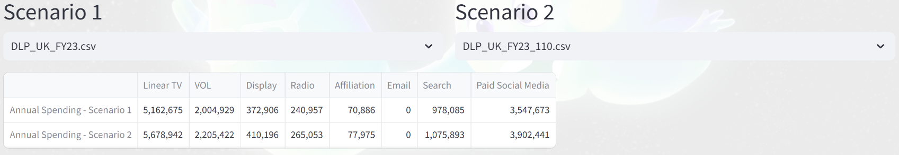

Scenario Planning
How would my attendance look like with my current plan?
User Input 2 – Choosing Scenarios
Once uploaded the files, select the desired scenario tab. A summary table of annual spendings by media will show up
After this, hit the button and we are good to go!

Slide 12
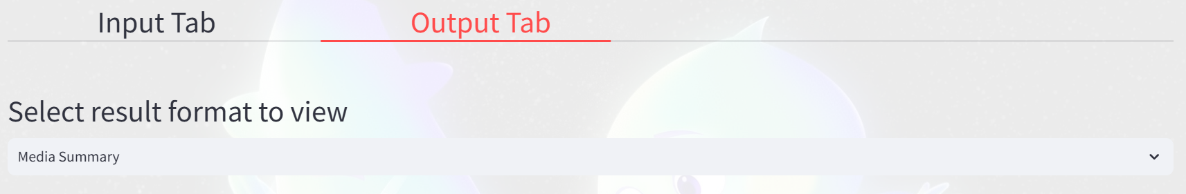
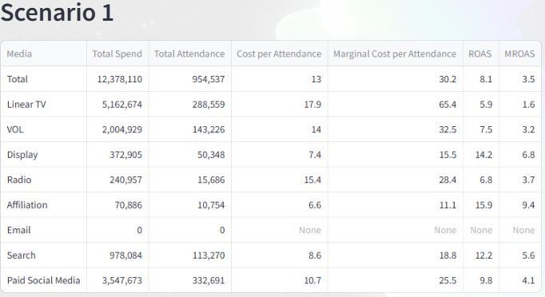
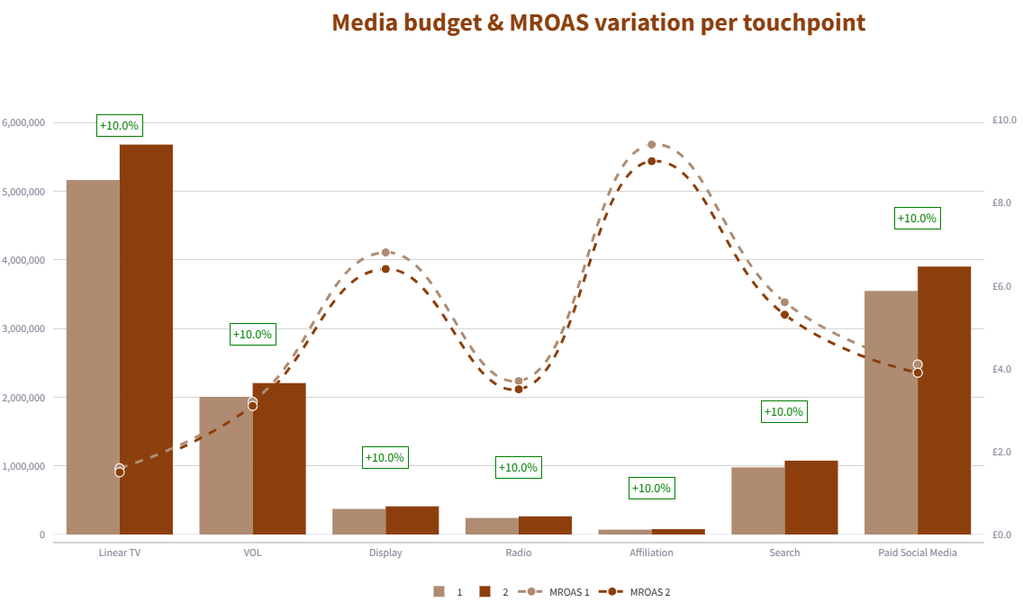
Scenario Planning
How would my attendance look like with my current plan?
Results – Aggregate Summary
In “Output Tab”, select “Media Summary”
Annual level summary table and graphical comparison will show up for both scenarios

Slide 13
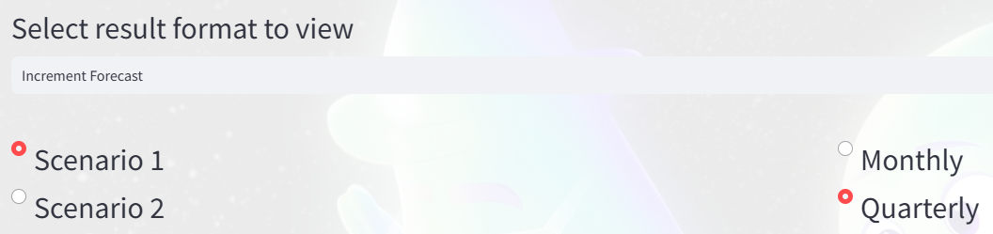
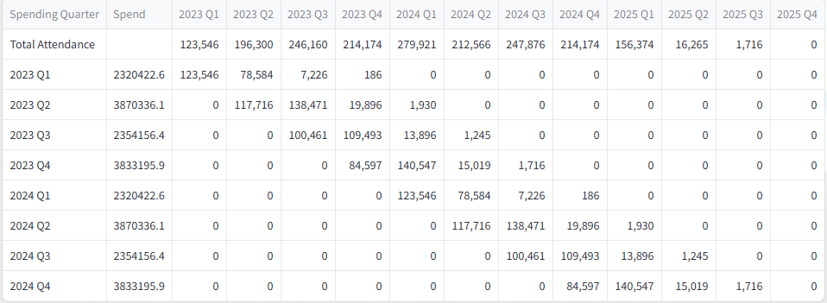
Scenario Planning
How would my attendance look like with my current plan?
Results – Attendance Forecast
In “Output Tab”, select “Increment Forecast”
Select corresponding scenario and timeframe

Slide 14
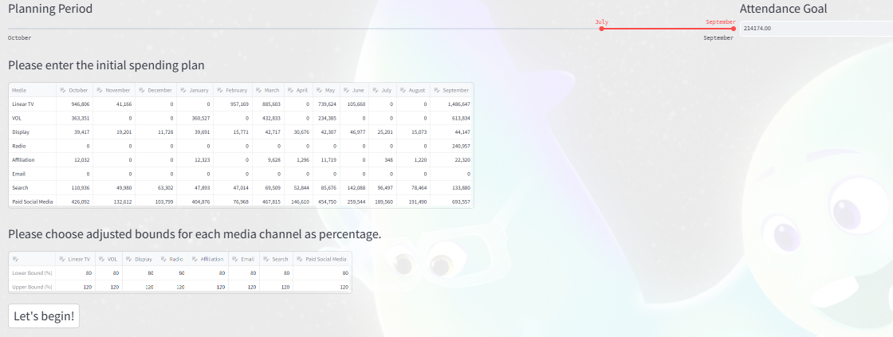
Budget Minimizing
How do I drive X amount of attendance, with minimal media budget?
User Inputs
- Plan Period
- Attendance Goal
- Initial Plan
- Adjust Range
E.g. We can use FY23 spend, and try to achieve the same attendance level of Q4 with lower budget

Slide 15
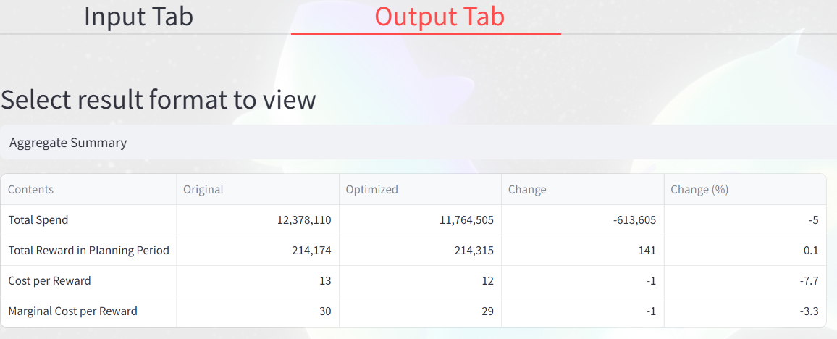
Budget Minimizing
How do I drive X amount of attendance, with minimal media budget?
Aggregate Summary – In this case, we spend 5% less budget (-€613,605) and achieve even higher attendance level (214,315 V.S. 214,174) for Q4 with the optimized budget

Slide 16
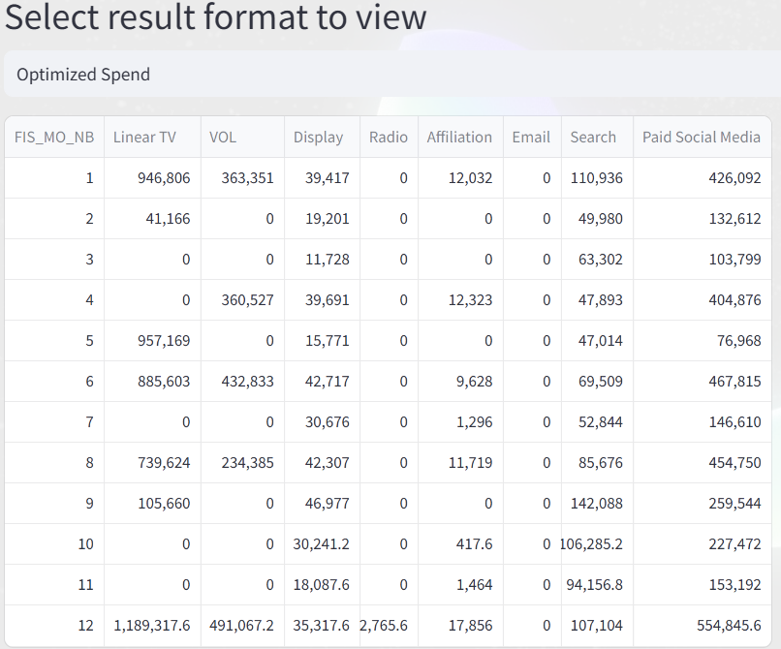
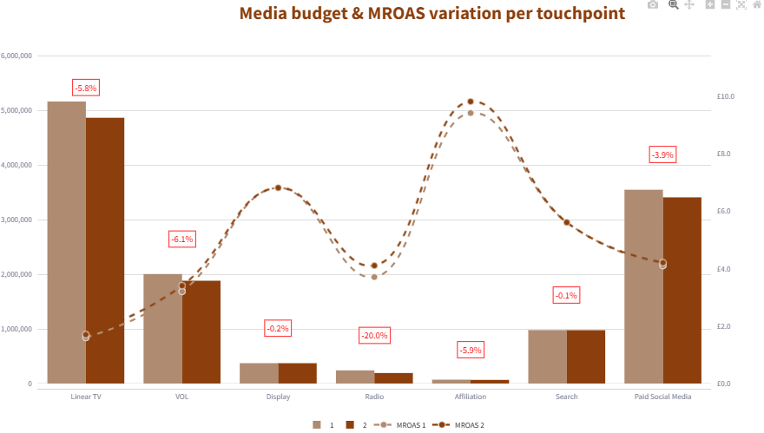
Budget Minimizing
How do I drive X amount of attendance, with minimal media budget?
Details by Media

Slide 17
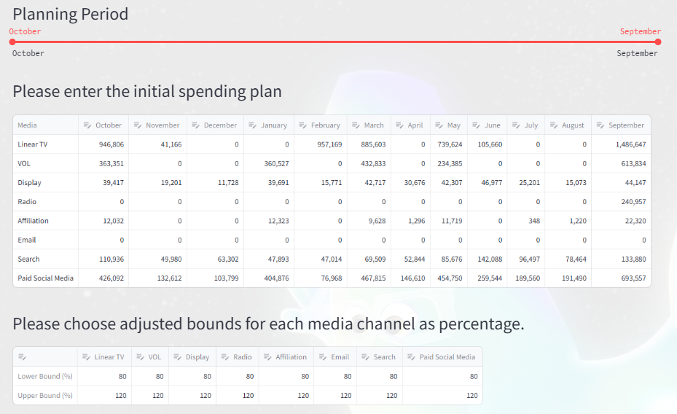
Attendance Maximizing
With the same total budget, how do I change current plan to maximize attendance?
User Inputs
- Plan Period
- Initial Plan
- Adjust Range
E.g. We can use FY23 spend and modify the entire year to maximize attendance

Slide 18
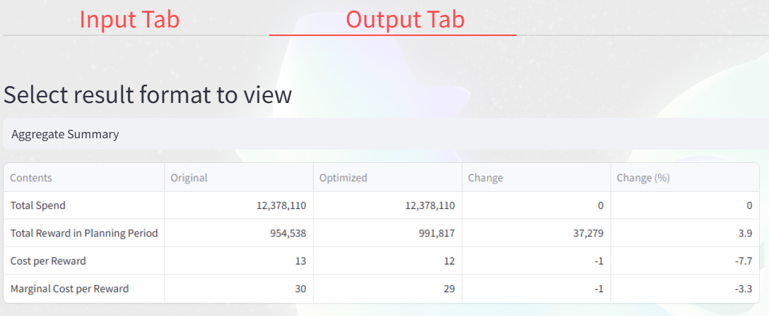
Attendance Maximizing
With the same total budget, how do I change current plan to maximize attendance?
Aggregate Summary – In this case, we use the same amount of total budget but drives 37,279 more attendance (€3,914,295 higher revenue) for the entire year

Slide 19
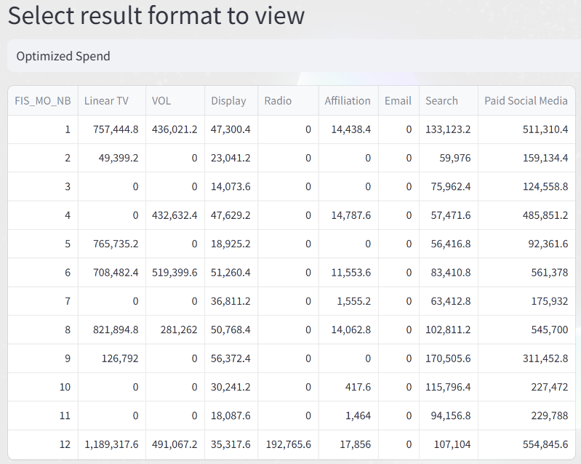
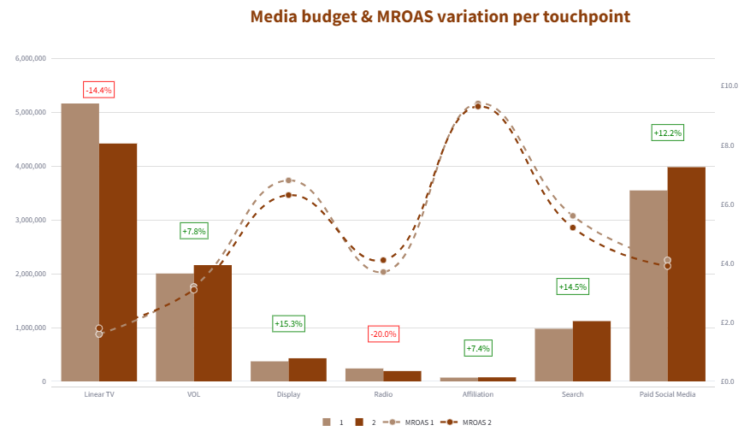
Attendance Maximizing
With the same total budget, how do I change current plan to maximize attendance?
Details by Media

